Slide 1
Module 1: Introduction to Azure Machine Learning

Slide 2
Agenda
Overview Azure AI Platform
AI Service Types
Preparing data at scale for ML
Azure ML Conceptually
Azure ML Tools and Interfaces
Deploying our Lab Environment

Slide 3
Ovrview Azure AI Platform

Slide 4

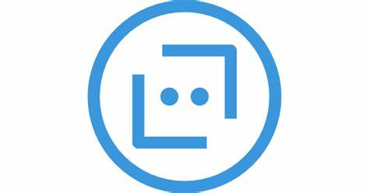
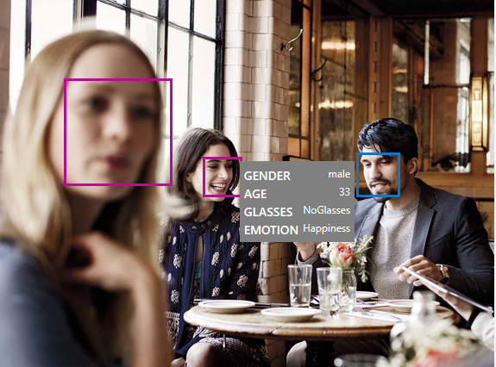
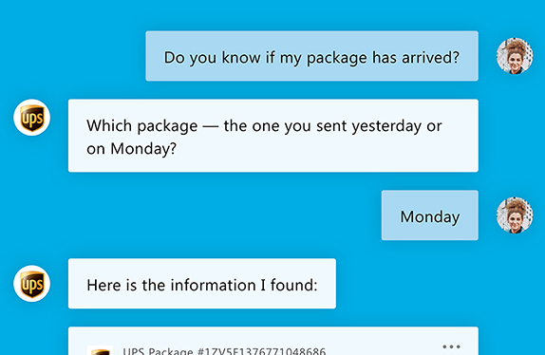
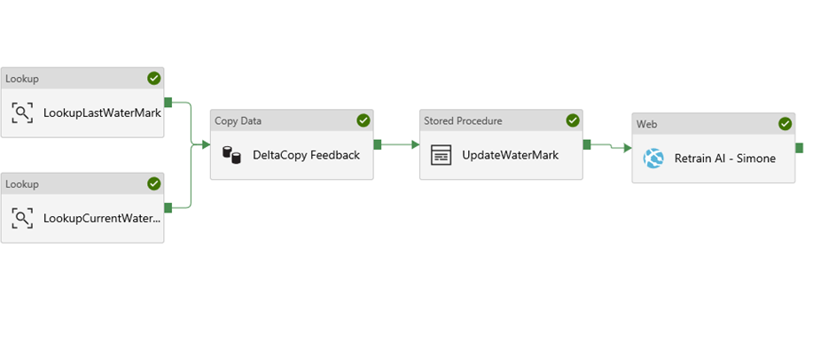
AI Service Types
…
…..
Vision
Speech
Language
Search
Azure Machine Learning
Azure Databricks
Azure Bot Service
Pre-Built AI
Custom AI
Conversational AI
Notes:
#9 => Case Batch Identification
Talking points:
Pre-built AI: reduce time to market; use record-winning AI developed by MSR
Pre-built customizable AI: use your business knowledge and data to create domain-specific custom AI.
Converational AI: chatbot services.
Dynamics integrates out-of-the-box with many of these services.
Balance between Pre-built and Custom AI
Discuss about using the symptoms extraction for HSP 02

Slide 5

Azure AI Platform
AI Services
Custom AI
Pre-built AI
Conversational AI
…
…..
Azure Machine Learning
Azure Databricks
Vision
Speech
Language
Search
Azure Bot Service
Data
Compute
SQL
Data Lake
Cosmos DB
Blob
AML Compute
ACI
AKS
(Databricks) Spark
Data Science VM
CPU
GPU
FPGA
Notes:
Talking points:
Pre-built AI -> Cognitive Services -> Domain specific pretrained models. Reduce time-to-market.
Continuously new services added. There’s now even a service to let your bots produce small talk...
Custom AI:
Productivity tooling to empower data science and development teams. Abstraction over infrastructure.
AzureML and AutoML helps to create a high quality model more efficiently, by using intelligent automation and optimization to figure out the right algorithm and parameters to use.
Bring your own Open Source Software. AI services let you run these services productively at scale.
The rest of the platform natively integrates with these services: D365 and domain-specific service usage.

Slide 6
Typical customer challenges
spending a lot of time on infrastructural work instead of being productive doing actual data science
challenges to let code scale to (/ run on) different infrastructure / environments
complexity in reproducing or comparing modeling results
lack of a good (automated) process to continuously roll out new models
hard to keep track of what model version is deployed where
manual tasks consuming lots of time that could potentially be automated
lacking insights on how your model performs once deployed
challenge to operate and providel lineage on model inferencing results

Slide 7
Positioning Azure ML
Your code base and environment
Azure Machine Learning
Data and ML Productivity Tooling
Data
Attached Compute
SQL
Data Lake
Cosmos DB
Blob
AML Compute
ACI
AKS
(Databricks) Spark
Data Science VM
CPU
GPU
FPGA
Notes:
Talking points:
Pre-built AI -> Cognitive Services -> Domain specific pretrained models. Reduce time-to-market.
Continuously new services added. There’s now even a service to let your bots produce small talk...
Custom AI:
Productivity tooling to empower data science and development teams. Abstraction over infrastructure.
AzureML and AutoML helps to create a high quality model more efficiently, by using intelligent automation and optimization to figure out the right algorithm and parameters to use.
Bring your own Open Source Software. AI services let you run these services productively at scale.
The rest of the platform natively integrates with these services: D365 and domain-specific service usage.

Slide 8
Preparing data at scale for ML
Azure Synapse or Azure Databricks
Azure Machine Learning
Offers a collaborative notebook-based Spark environment and CPU/GPU compute options.
Focus on data warehousing and data exploration capabilities.
Optimized Apache Spark engine
Train with SparkM LLib
Optimal when workloads are Spark-based.
Interact with the service through portal or remote Spark session.
Offers ML job scheduling, managed compute and orchestration, ML experimentation tracking, model management and deployment capabilities.
Focus on ML training productivity, lineage and ML dataset/model management, ML DevOps.
Offers serverless compute + BYOC options for training and inference.
Bring-your-own docker images, dependencies, runtimes.
Interact with the service through SDKs, CLI, portal.
Azure Storage
Dataset size
Attach Spark Compute from Synapse and Databricks to Azure ML for datasets that are huge in size
Huge
Small

Slide 9
Azure ML building blocks

Slide 10
Data Science Building Blocks Project
Prepare data, train models
Hyperparameter tuning
Experimentation and pipelines
Deployment
Monitor and Retrain
Classical ML
Deep learning
Data
Data stores
Data sets
Managed Compute
Azure Machine Learning compute cluster

Slide 11
Azure Machine Learning service
Set of Azure Cloud Services
Python SDK
That enables you to:
Prepare Data
Build Models
Train Models
Manage Models
Track Experiments
Deploy Models

Slide 12
Training Infrastructure
Dependencies and Containers
Leverage system-managed AML compute or bring your own compute
Distribute data
Manage and share resources across a workspace
Schedule jobs
Train at cloud scale using a framework of choice
Scale resources
Autoscale resources to only pay while running a job
Provision clusters
Use the latest NDv2 series VMs with the NVIDIA V100 GPUs

Slide 13
Wide choice of hardware
CPUs
GPUs
FPGAs
General purpose machine learning
D, F, L, M, H Series
Deep learning
N Series
Specialized hardware accelerated deep learning
Project Brainwave
Optimized for flexibility
Optimized for performance
FPGA NEW UPDATES:
Support for image classification and recognition scenarios
ResNet 50, ResNet 152, VGG-16, SSD-VGG, DenseNet-121
Notes:
We have the most comprehensive AI infrastructure
From general purpose CPUs to specialized HW (FPGAs)
FPGA -> lowest cost inferencing. Lower than Google’s TPUs
Most comprehensive set of GPU options so customers can choose the right one for their project. (best price/performance)
<Transition> Let me move to the last part of our ML portfolio.

Slide 14
Experimentation
Leverage service-side capture of run metrics, output logs and models
Manage training jobs locally, scaled-up or scaled-out
80%
75%
90%
95%
85%
Use leaderboards, side by side run comparison and model selection
Conduct a hyperparameter search on traditional ML or DNN

Slide 15
Model management
Create/Retrain Model
Enable DevOps with full CI/CD integration with VSTS
Register Model
Track model versions with a central model registry
Monitor
Oversea deployments through Azure AppInsights

Slide 16
Azure Machine Learning pipelines
Prepare data
Build & train models
Deploy & predict
Data Preparation
Model building & training
Model deployment
Data ingestion
Normalization
Hyper-parameter tuning
Deployment
Transformation
Automatic model selection
Batch scoring
Validation
Model testing
Data storage locations
Featurization
Model validation

Slide 17
Advantages of Azure ML Pipelines
Unattended runs
Schedule a few steps to run in parallel or in sequence to focus on other tasks while your pipeline runs
Tracking and versioning
Name and version your data sources, inputs and outputs with the pipelines SDK
Reusability
Create templates of pipelines for specific scenarios such as retraining and batch scoring
Mixed and diverse compute
Use multiple pipelines that are reliably coordinated across heterogeneous and scalable computes and storages

Slide 18
Deploy Azure ML models at scale
Azure Machine Learning Service
Cognitive Services
Model Registry
Your IDE
Image Registry
Image Registry
Cloud Service
Azure Machine Learning Experimentation
Heavy Edge
Register Model
Scoring File
Create & Register Image
Deployment & Model Monitoring
Light Edge
External Model

Slide 19
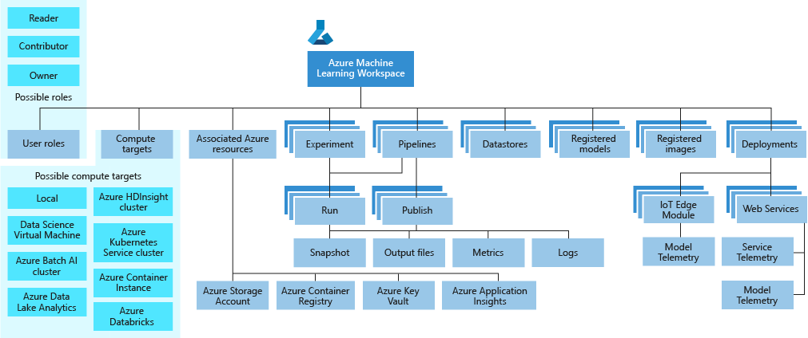
Taxonomy of concepts

Slide 20
Tools and Interfaces

Slide 21


Tool Agnostic Python and R SDK
PyCharm
Jupyter
Visual Studio Code
Use your favorite IDEs, editors, notebooks, and frameworks
Flexibility of your local environment or curated cloud environment
Integrate with other services like Azure Databricks
Get started quickly without any complex pre-requisites

Slide 22
ML Studio Demo

Slide 23
Deploying our lab environment

Slide 24
Lab requirements
Follow the steps on: https://github.com/miquelladeboer/workshop-azure-machine-learning/blob/master/labs/01_setup.md

